Slide 1
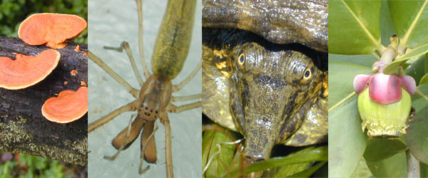
GENERAL BIOLOGY fdn 1203
Dr. Theja Abayarathna
Department of Biology
Faculty of Applied Sciences
Rajarata University of Sri Lanka

Slide 2
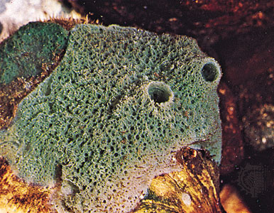
Phyllum: Porifera
Called pore bearers as their body wall contain minute pores.
All are aquatic marine or fresh water.
Ex. Euspongia

Slide 3
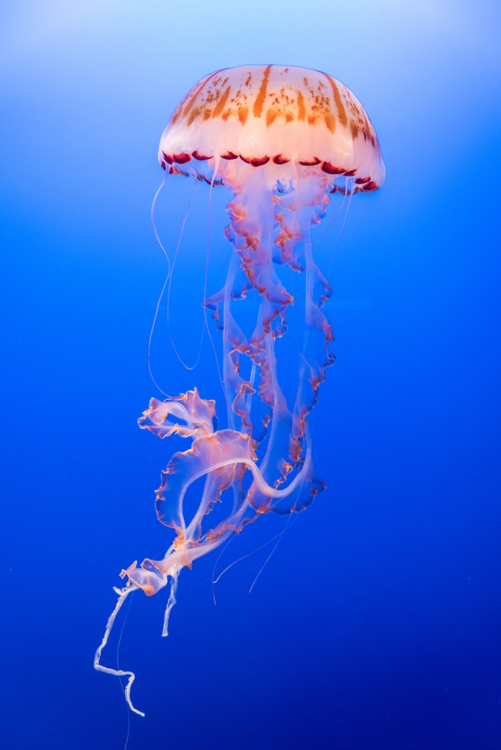
Phylum Cnidaria
Radial symmetrical animals
They have specialized cells
called Cnidocytes – “stinging cells”
Ex. jellyfish

Slide 4
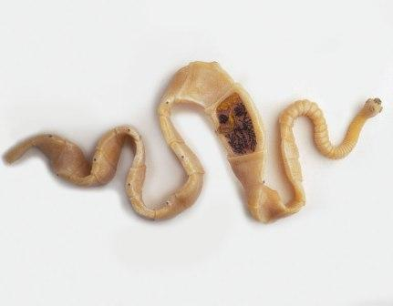
Phylum Plathyhelminthes (Flatworms)
Soft, dorso-ventrally flattened animals with bilateral symmetry
Most are parasitic.
Ex. Taenia solium

Slide 5
Phylum Nematoda
Commonly known as round worms
Occur almost every where in soil, fresh water, salt water and as parasites in the body
Body wall is covered by a tough cuticle

Slide 6
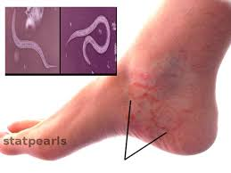
Ex: Ancylostoma- Hook worm infection

Slide 7
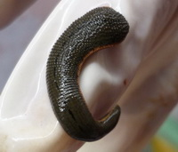
Phylum Annelida
Elongated segmented body.
Body is covered by a transparent cuticle.
Ex. Hirudinaria - Leech

Slide 8
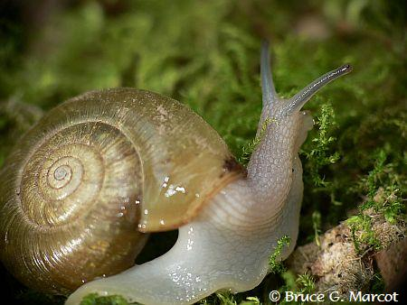
Phylum Mollusca
Live in fresh water, marine water and on land.
Soft bodied.
Have a muscular foot used for locomotion
Ex. Snail

Slide 9
Phylum Arthropoda
Largest group of animals
Reasons for the success of Arthropods:
Chitinous exoskeleton
They have a unique chitinous (made up of chitine) cuticle which is light weight and tough.

Slide 10
It protects the animals from predators.
It is impervious to water and so protects the body from drying and has made the arthropods survive on land in almost all types of environments.
Insects have chitinous wings that help them to fly.
The biting mouth parts, lenses for the eye, and sensory organs are also made up of chitin.

Slide 11
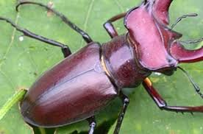
Chitinous exoskeleton of beetle

Slide 12
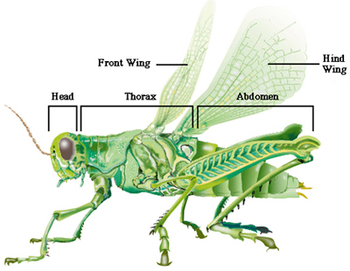
2. Segmentation
Body is segmented into distinct regions as head, thorax, and abdomen; each one is specialized to perform a specific function.

Slide 13
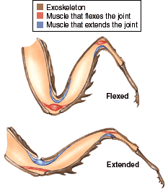
3. Jointed appendages
The appendages have been modified to perform different functions.
It increases the efficiency and complexity of the activity.
It is also help the arthropods to adjust to different habitats.

Slide 14
4. Ecdysis/molting
The chitinous skeleton does not allow the body to grow and hence to overcome it, ecdysis has evolved.
The animal shed off the exoskeleton periodically and grows larger and secretes the new exoskeleton.

Slide 15
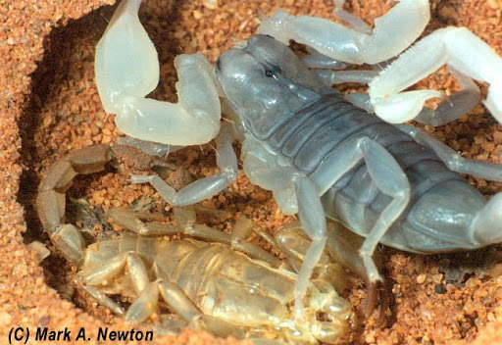
Ecdysis of scorpion

Slide 16
Phylum Echinodermata
All are marine animals
Spiny skinned animals. The spines fixed or movable.
Radial symmetrical animals with a water vascular system
Have a anterior- posterior flattened body.

Slide 17
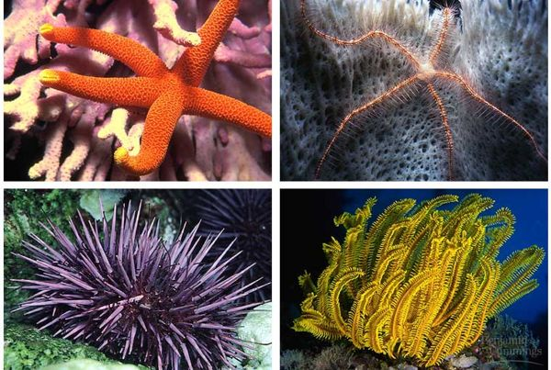
Echinoderms

Slide 18
Thank you!
See you next week!

